Slide 1
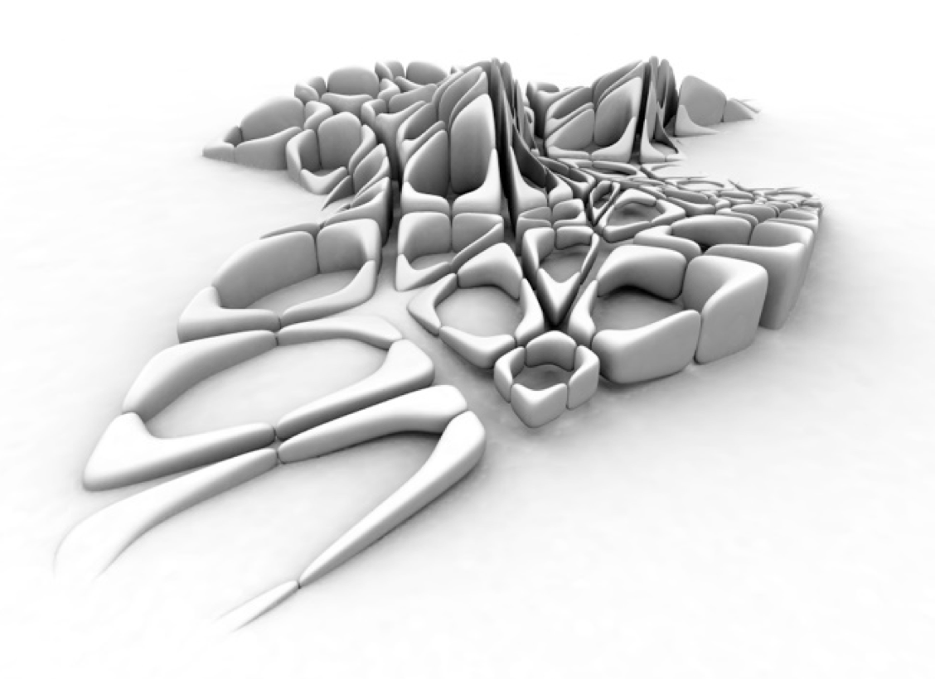
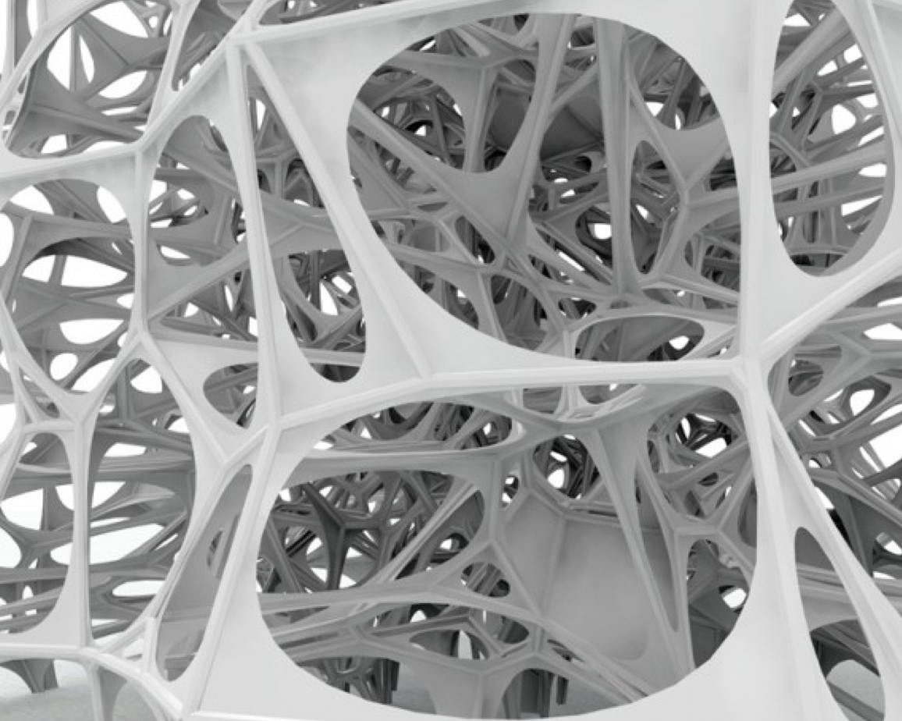
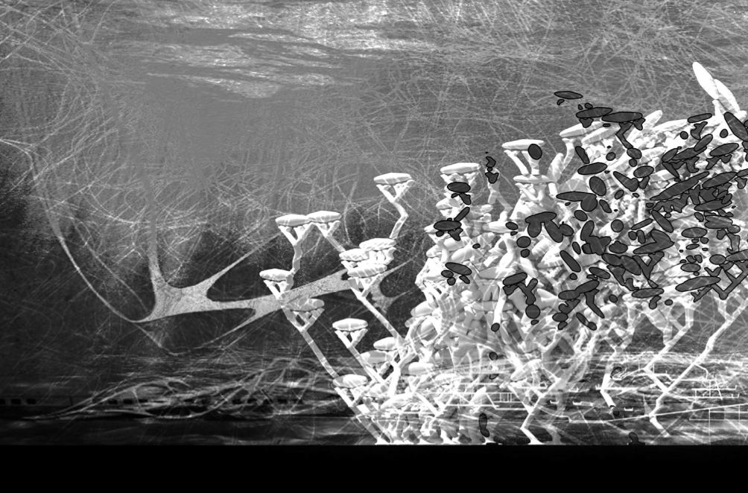
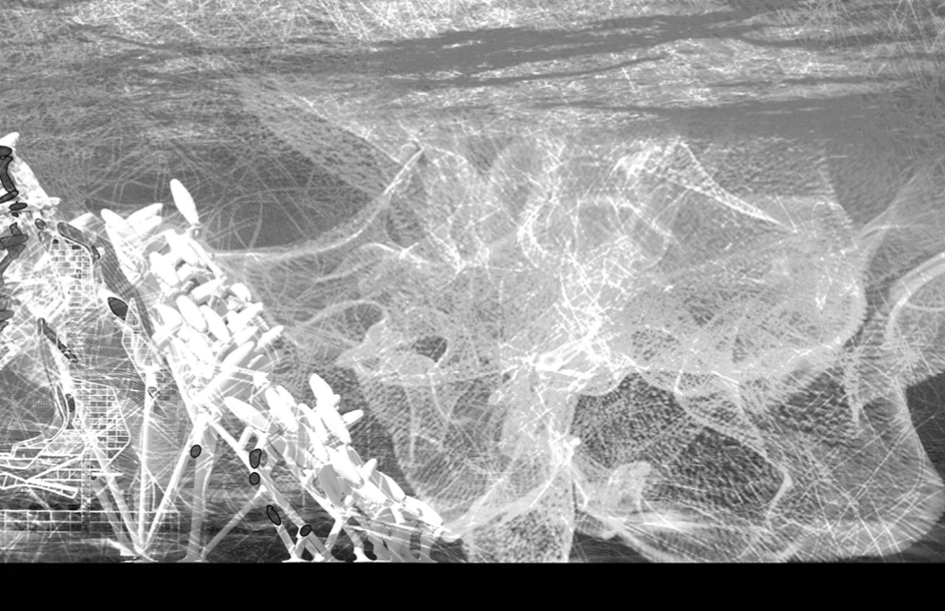
L-systems (LS)
Cellular automata (CA)
Genetic algorithms (GA)
Agent Based Models
Shape grammars (SG)
Parametric desing (PD)
https://www.researchgate.net/publication/240759315_Chaos_and_Geometric_Order_in_Architecture_and_Design
Notes:
CA is a collection of cells on a grid of a specified shape that evolve over time according to a set of rules driven by the state of the neighbouring cells
As a result, the outcomes of CA are often complex and difficult to predict. The basic components for composing design using CA are cells. Although there are mechanisms to transform cells during the application, in general, cells and their available operations are limited and are constrained by the type of grid adopted.

